Slide 1
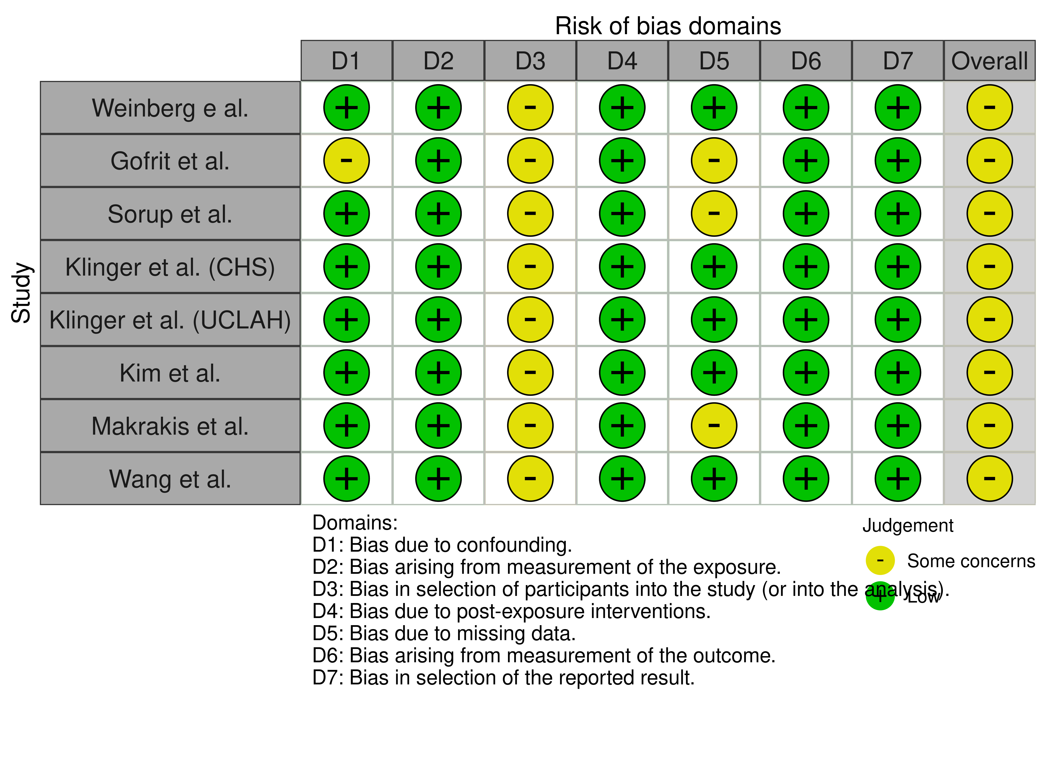
Figure S1: Risk of bias assessment.

